Slide 1
ENS – Cross-border Finance/English law Debt Finance Capabilities
July 2024

Slide 2

PRACTICE AREAS
In the cross border finance space, we deliver on debt financing mandates across the spectrum. From structured, trade and commodity finance to development / project finance to general corporate debt we have wide-ranging experience and expertise to assist our clients on cross-border financing initiatives.
REPUTABLE RELATIONSHIPS WITH STRATEGIC ADVISORS IN AFRICA AND INTERNATIONALLY
As an independent law firm, we work with the most suitable correspondent counsel in those jurisdictions where we don’t have offices. We have close relationships with experienced and reputable finance lawyers across the continent.
IN-COUNTRY EXPERIENCE
ENGLISH LAW AT ENS
In addition to our English law capabilities we have fully integrated offices in South Africa, Uganda, Ghana, Rwanda, Namibia, Kenya and Mauritius. From these offices we provide a full debt advisory service whether in the context of a cross border transaction or on a domestic level.
ENS has English law qualified and experienced banking and finance solicitors based in our Johannesburg and Nairobi offices. We are able to advise fully as English law and lead transaction counsel on banking and finance mandates across the continent across various sectors and under different structures.
RECOGNITION
PROXIMITY AND VALUE
Our ability to deliver on cross-border mandates, acting as English law and lead transaction counsel, is well recognised by the market. We are a panel firm of prestigious clients such as IFC, AFC, TDB, and other development finance institutions. We routinely advise international DFI’s on their inbound African debt investments as well as commercial banks, private equity funds, traders and others. Almost all of our lawyers are Chambers ranked with a primary focus being cross-border inancing deals on the African continent.
We are able to cost-effectively deliver on complex cross-border financings. We lawyer African deals on the African continent from our African offices. Being on the ground in Africa we are able to attend on meetings and be present in person where the circumstances require.

Slide 3
Some of our selected cross-border experience (where we have acted as English law and lead transaction counsel):
Advised Nedbank as arranger and agent for various syndicated financings for the ETG Group.
Advised RMB on a USD 100 million sovereign loan for the Ivory Coast to finance underlying trade loans (MIGA backed).
Advised The International Finance Corporation (“IFC”) and Investeringsfonden for Udviklingslande (“IFU”) in a secured loan financing to be provided by the IFC and IFU to INSTA Products. The financing provides INSTA Products with critical working capital.
Advised a large consortium of lenders in an English law governed syndicated $306m sustainability-linked real estate lending transaction arranged by SBSA for GRIT Real Estate Income Group Limited.
Advising IFC and FMO on its financing of USD 35 million to Pearl Dairy Farms Limited, Maziwa and Musty Distribution Limited to finance the companies capacity expansion plans in Uganda and in Kenya including the upgrade and capacity increase of the powder milk plant in Uganda, and the acquisition of a packing plant in Kenya, and refinancing of an existing Standard Chartered Bank loan in Uganda.
Advised the by Coöperative Rabobank U.A on the financing of USD 108 million by Coöperative Rabobank U.A. and The Standard Bank of South Africa Limited to Czarnikow Group Limited (Incorporated in the United Kingdom and registered as a branch in Uganda).
Advised Vodacom Group as borrower counsel on the debt raising aspects of its acquisition of a 55% stake in Vodafone Egypt from Vodafone Group.
Advised Africa Finance Corporation on a USD50 million West African fuel trade financing borrowing base facility for Gemcorp.
Advised IFC and Proparco on a USD22 million hotel financing in Kenya for the Kasada group
Advised RMB, BGFI Bank and syndicates of lenders on two sovereign debt deals for the Government of the Ivory Coast
Advised FMO, IFC and IFU on a EUR 30 million DFI syndicated debt package for the United Exports Group
Advised Norfund and IFU on a debt rescue package for the Asilia Group
Advised Africa Finance Corporation on a USD 16 million tank farm financing in Monrovia for the Conex Group
Advised Lendable Asset Management on the financing of USD 20 million to Pan African Auto Access Limited (a company incorporated in the Republic of Ugandan) and Autochek SAS (a company incorporated in the Republic of Côte d’Ivoire). Our role involved conducting a due diligence on the borrower.

Slide 4
Some of our selected cross-border experience (where we have acted as English law and lead transaction counsel):
Advised Nedbank on various structured trade and commodity finance deals, including the USD 30 million metals borrowing base facility for Traxys; and the USD 20 million chrome borrowing base financing for Tharisa plc
Advised Absa on an import financing structured trade facility for Merec (Mozambique)
Advised Absa on a CMA commodities financing for Tennant Metals
Advised Nedbank and Absa on a prepayment facility for Trafigura (DRC and Zambia)
Advised IFC on a USD 150 million term loan facility for The Co-Operative Bank Kenya Limited
Advised DEG and Proparco on a EUR 75 million dual tranche euro term loan facility for the Mauritius Commercial Bank
Advised Standard Chartered Bank on a USD 25 million term facility for Gulfstream (Uganda)
Advised Standard Bank, RMB, Absa Bank, ABSA, HSBC and Nedbank on the debt restructuring of Eqstra Corporation’s ZAR 8-billion DMTN bond programme and corporate debt as part of a complex merger transaction entered into between enX and Eqstra
Advised Coca Cola Mozambique on a MZN 4,564 million syndicated facility provided by Standard Bank South Africa, Banco Commercial e de Investimentos. S.A., Banco Internacional de Moçambique, S.A., Barclays Bank Moçambique S.A. and FNB Moçambique S.A
Advised Absa on a structured PxF trade facility for Afro Minerals
Advised Barak Fund on a USD 50 million borrowing base sugar financing for West Kenya Sugar Limited
Advised Barak Fund on a USD 43 million secured term loan facility for TSN Oils Tanzania and security sharing arrangements with Equity Bank Kenya
Advised Investec Bank, Standard Bank, RMB, Absa Bank and Nedbank on a ZAR 1.7-billion syndicated secured structured borrowing base financing facility for Macsteel
Advised IFC on an LPG gas power project for Sodigaz in Burkina Faso (on going)
Advised IFC on a USD 10m financing for EthioChicken (Ethiopia)
Advised IFC on a NAM$ 920m loan facility for Bank of Windhoek
Advised RMB on a USD 100 million MIGA insured sovereign trade line facility for the Republic of Ivory Coast (a GTR best deal of the year 2024)

Slide 5
ENS Core Team CVs

Slide 6
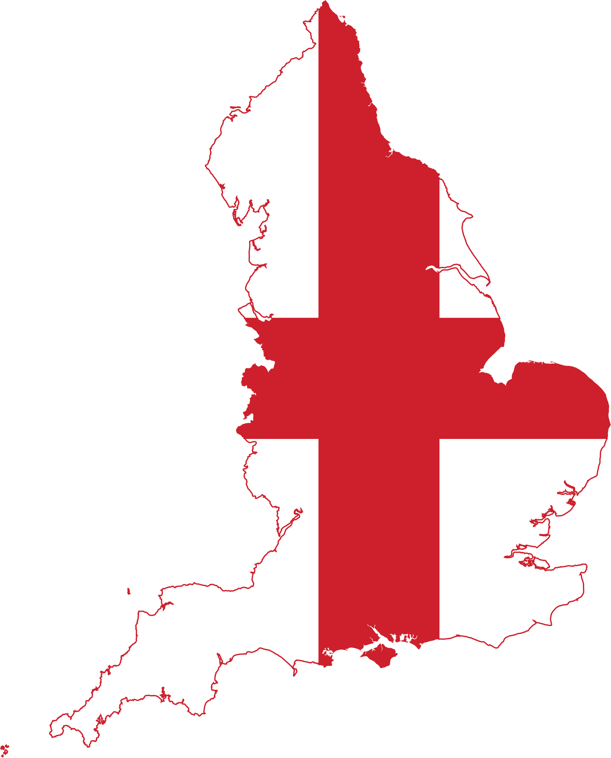

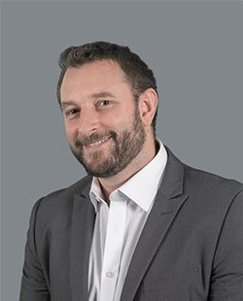


Craig Saven is an Executive and Head of the Banking and Finance practice at ENS. He specialises in cross-border and structured trade and commodity finance, with a particular focus on emerging markets. He also advises clients on their general corporate financings. Craig is qualified as both a South African Advocate and an English Solicitor. His dual qualifications allow him to navigate both South African and English law, facilitating cross-border transactions and ensuring compliance with international standards.
Craig trained and worked at a leading English law firm with a special focus on structured trade and commodity finance and emerging markets work.
Craig has advised major international banks, South African banks, development finance institutions (DFIs), and international financial institutions on various general corporate, development and structured trade and commodity financings. He has also advised borrowers in the mining, telecommunications, tourism, hotels and soft commodity sectors.
His experience includes advising on sovereign debt, structured trade financings, such as borrowing base facilities, pre-export finance facilities, post-shipment advance facilities, L/C issuance facilities and receivables/invoice discounting facilities. He also has experience in risk/sub-participations, syndicated loans, work-out/distressed debt arrangements, development finance and general corporate lending transactions.
Craig has been the lead adviser on structured trade and commodity financing deals awarded Deal of the Year by Global Trade Review. He is a regular speaker at Loan Market Association (LMA) conferences across Africa.
Qualifications :
Solicitor – High Court of England and Wales
Lawyer – Supreme Court of New South Wales
BBusSc (Hons) (University of Cape Town)
LLB (City University, London)
LLM (London School of Economics and Political Science)
Craig is recognised as a leading/recommended lawyer by:
The Legal 500 EMEA Guide 2024, 2023, 2022, 2021, 2020, 2019 – Banking and Finance – 2024, 2023 Investment Funds (South Africa)
Chambers Global Guide 2024, 2023, 2021, 2020, 2019 - Banking & Finance (South Africa)
Best Lawyers® 2023, 2022, 2021, 2020, 2019, 2018 – Banking and Finance, Structured Finance (South Africa)
CRAIG SAVEN
Head of Banking and Finance | South Africa
T: +27 82 310 5244
E: csaven@ENSafrica.com

Slide 7
Thank you

